Slide 1
System Testing
Done by:
Mariam Said Al-hashmi
Amal Hamood Al-jabri

Slide 2
Introduction:
What is System Testing?
Purpose of System Testing.
Analogy.
Method used.
Time Performed.
Performed by who?

Slide 3
Why is system testing important?
In Software Development Life Cycle the System Testing is perform as the first level of testing where the System is tested as a whole.
System Testing enables you to test, validate and verify both the Application Architecture and Business requirements.
In this step of testing check if system meets functional requirement or not.
The application/System is tested in an environment that particularly resembles the effective production environment where the application/software will be lastly deployed.

Slide 4
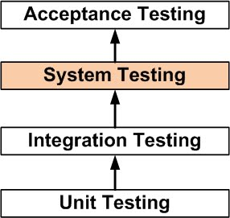
Different Hierarchical levels of testing:

Slide 5
What do you verify in System Testing?
Testing the fully integrated applications.
testing of every input .
user's experience .

Slide 6
Types of System Testing:
Usability Testing .
Load Testing
Regression Testing
Recovery Testing
Migration Testing
Functional Testing
Hardware/Software Testing

Slide 7
Thank you for your attention if u have any questions feel free to ask

